Slide 1
Employee Management System
By: Vinamra SIngh
Date of Submission:16/07/2023

Slide 2
About the Employee Management System (EMS)
EMS is a console application developed using C programming language.
EMS has functionalities like adding,deleting,updating and lisitng the employee records.
EMS uses file handling system to manage employee data effectivelty and retain said data.

Slide 3
CODE

Slide 4
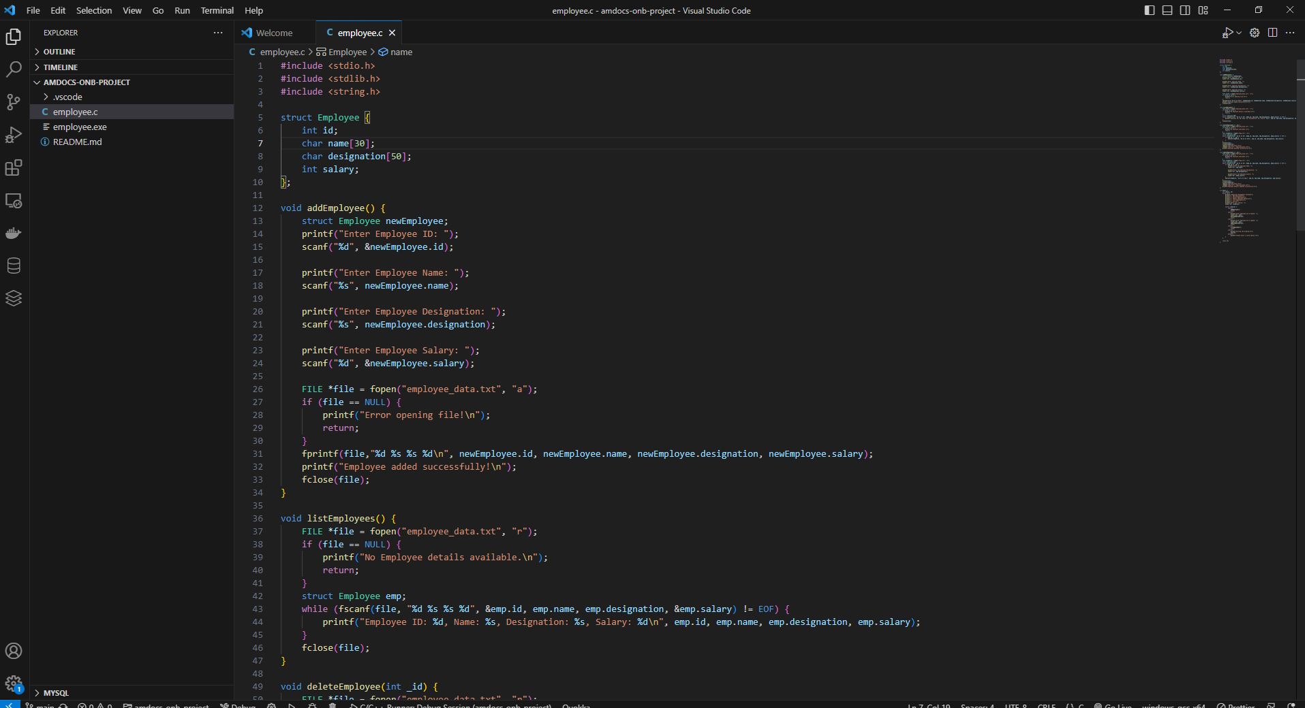

Slide 5
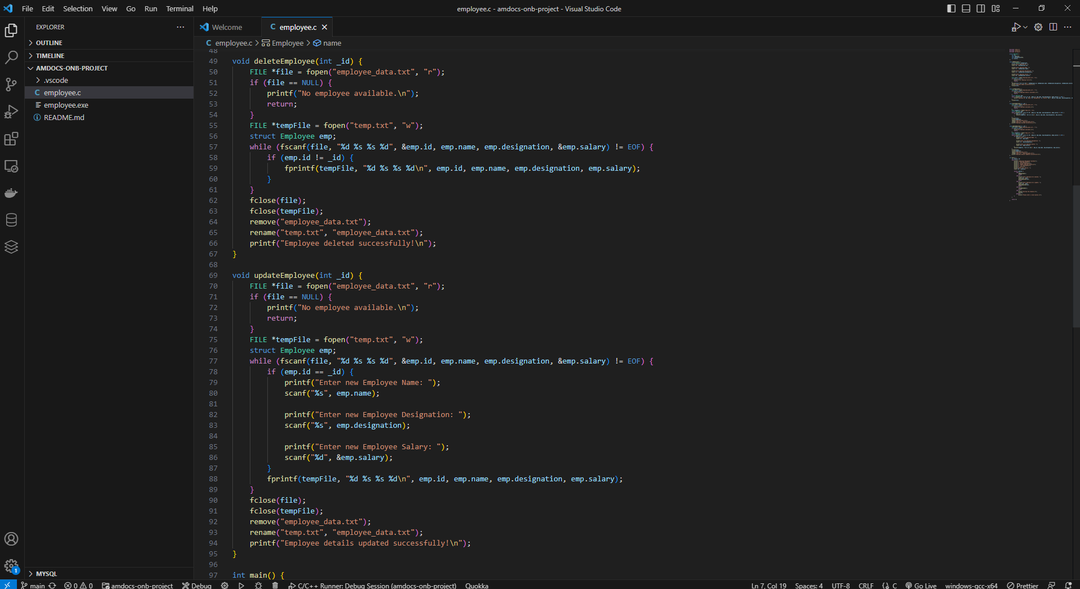

Slide 6
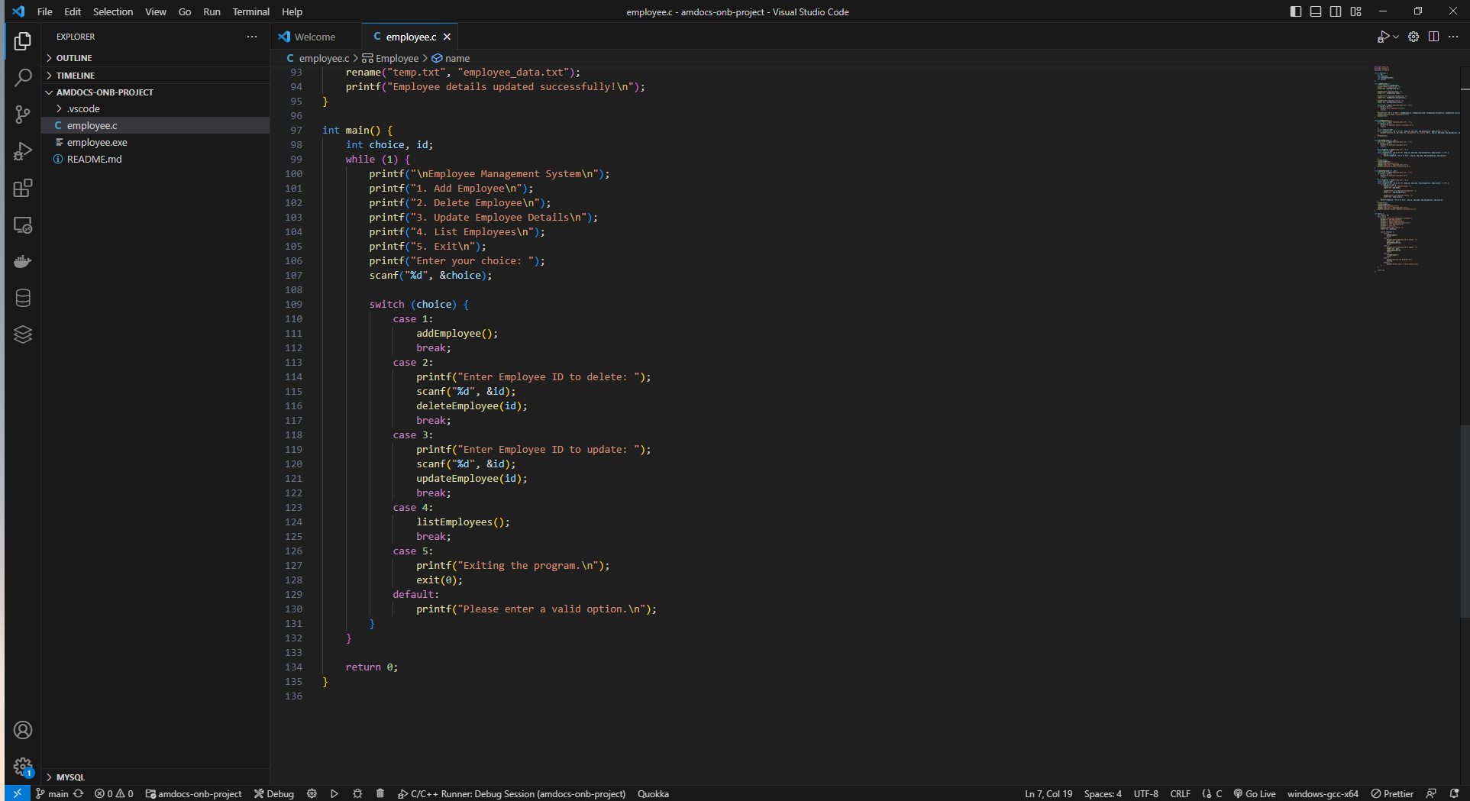

Slide 7
OUTPUT

Slide 8
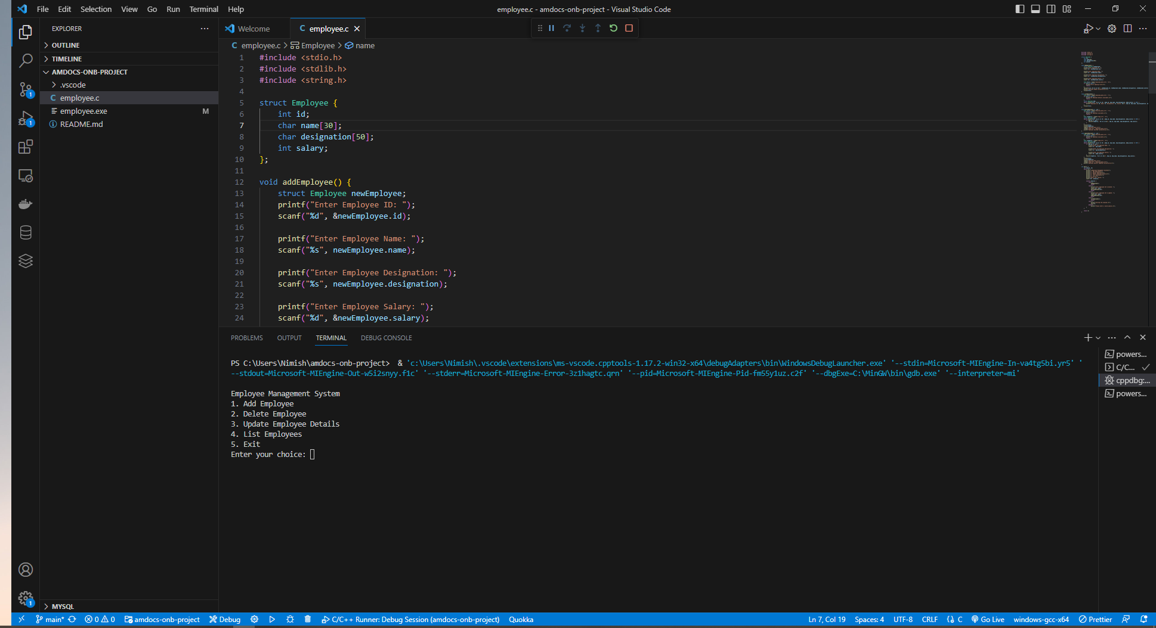

Slide 9
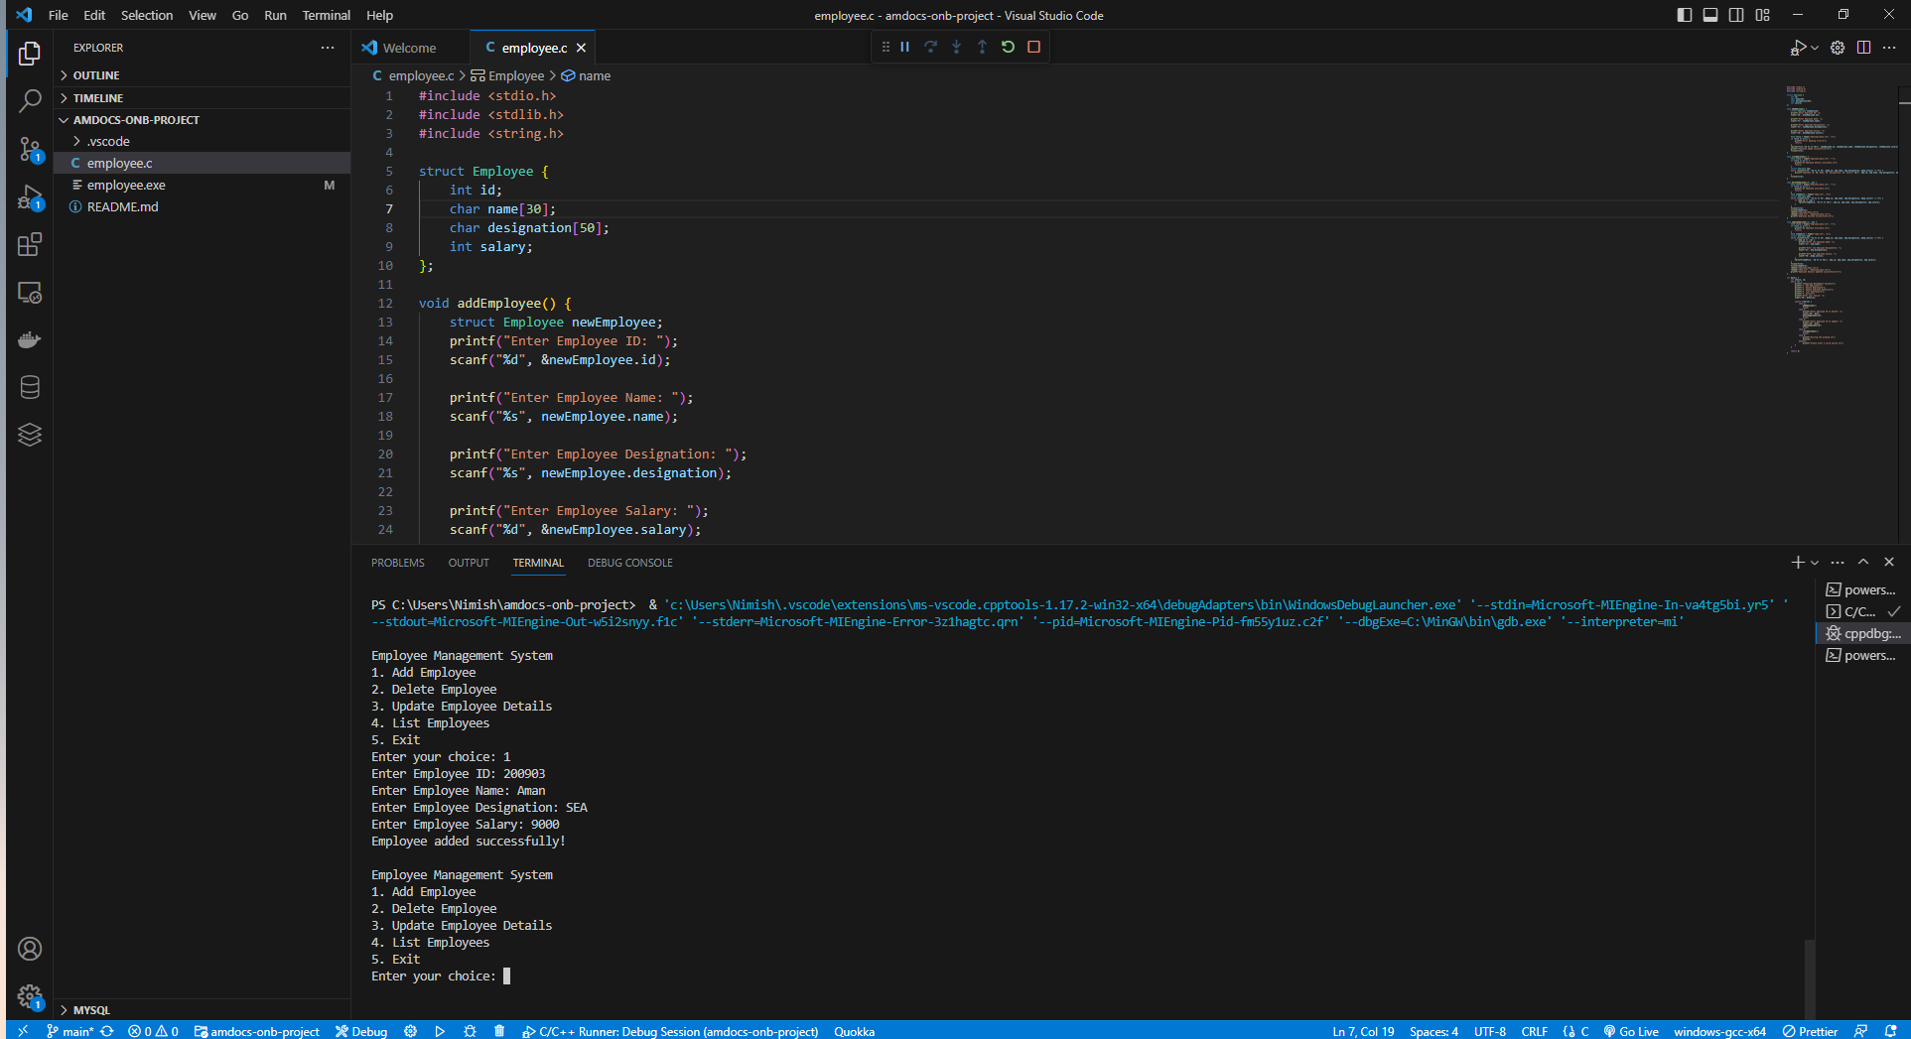

Slide 10
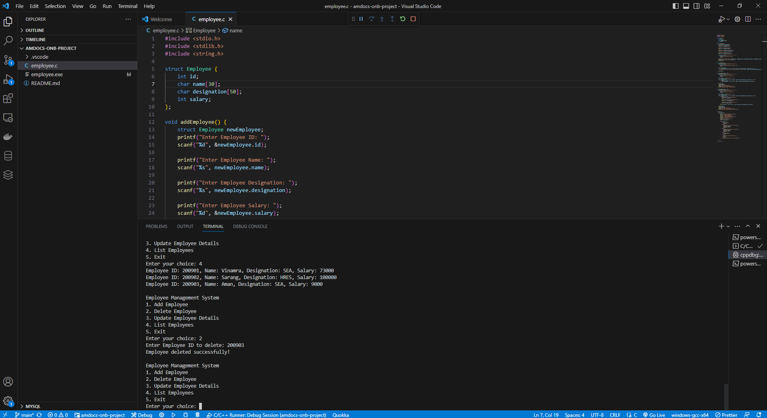

Slide 11
